Slide 1
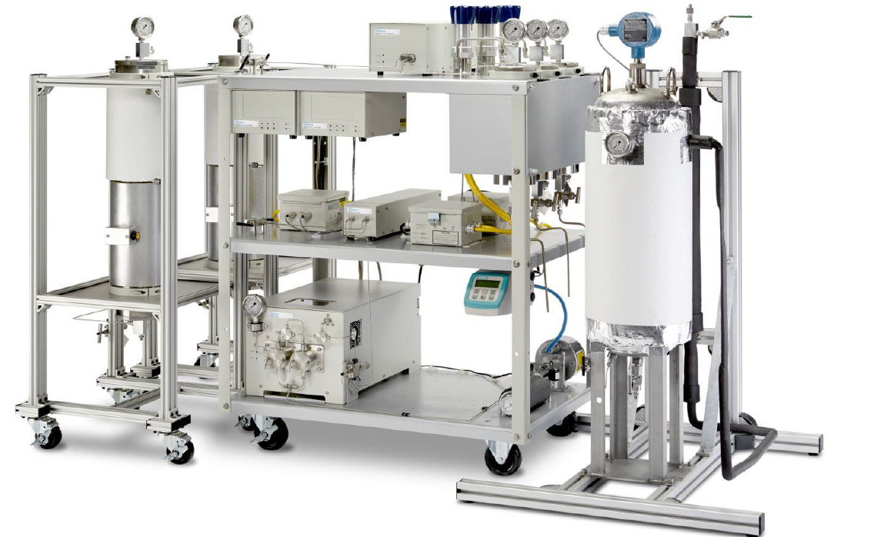
2x5L Bio-Botanical SFE system
Quick Reference Guide

Slide 2
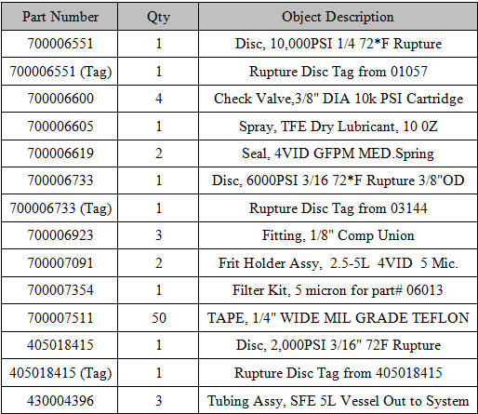
205001332:
SFE Bio-Botanical Spare Parts Kit

Slide 3
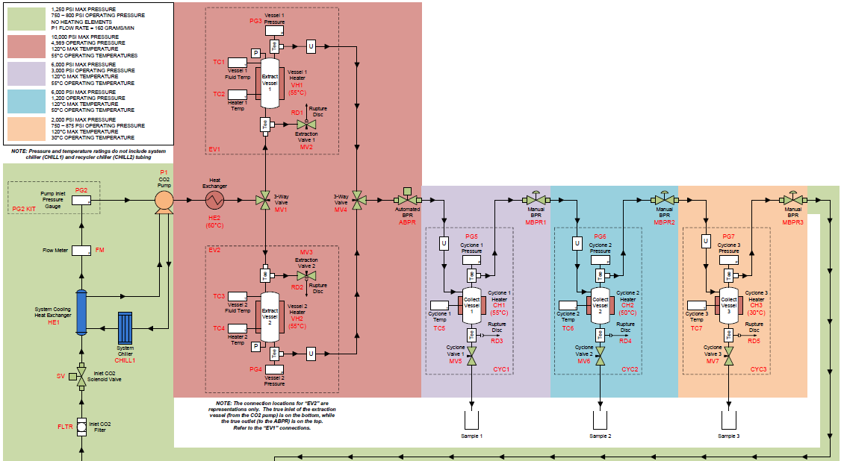
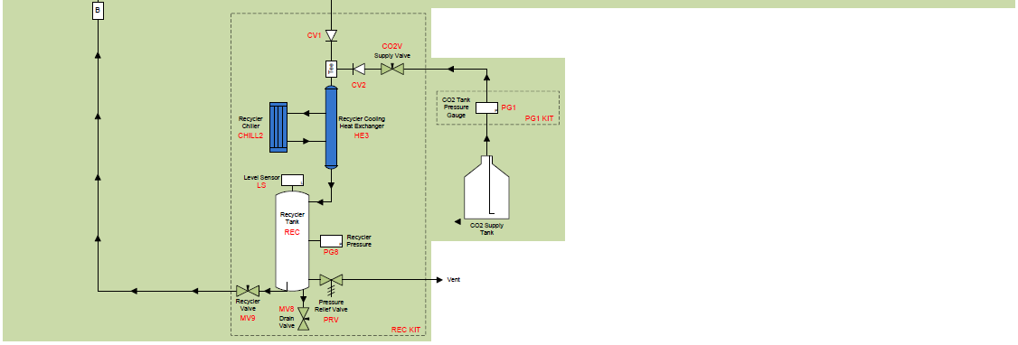
SFE 2x5L Schematic

Slide 4
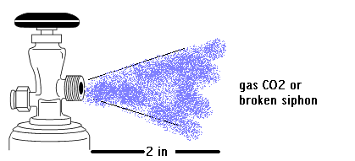
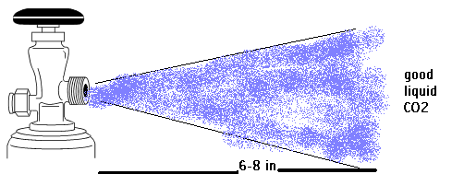
Fresh supply of CO2 to recycler

Slide 5
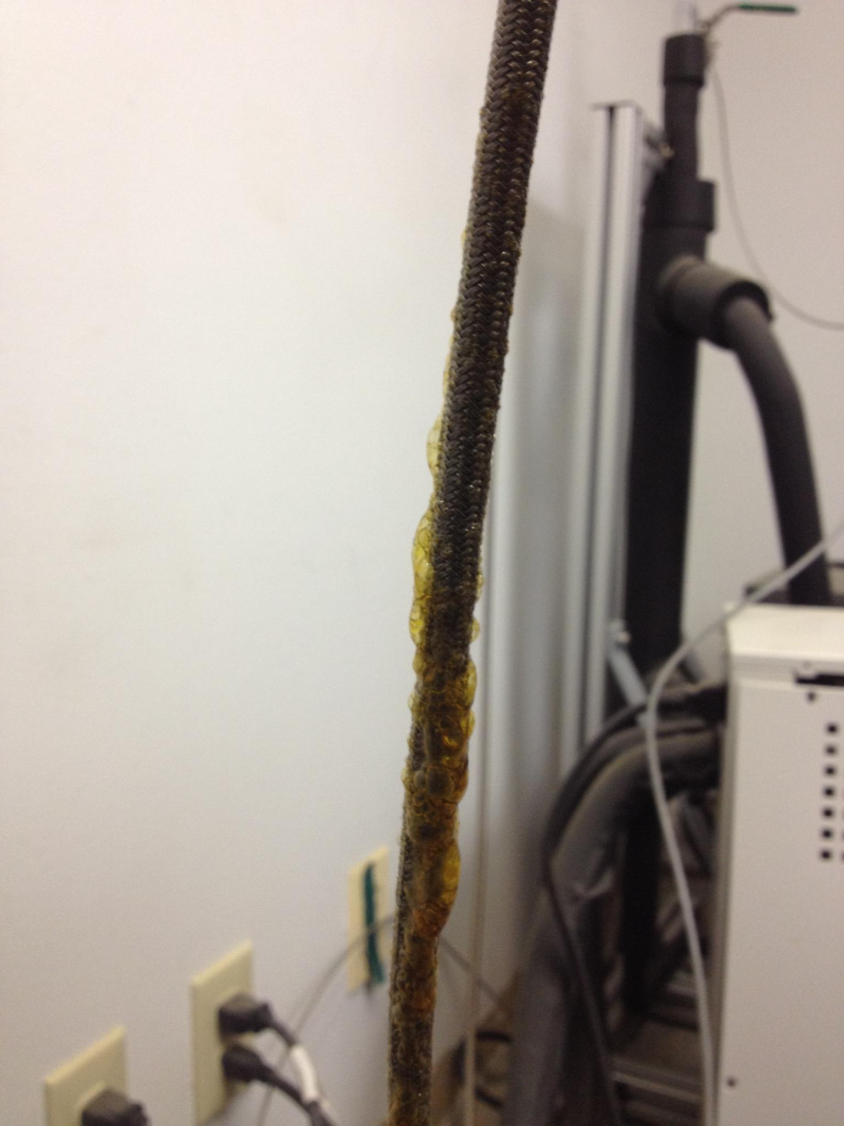
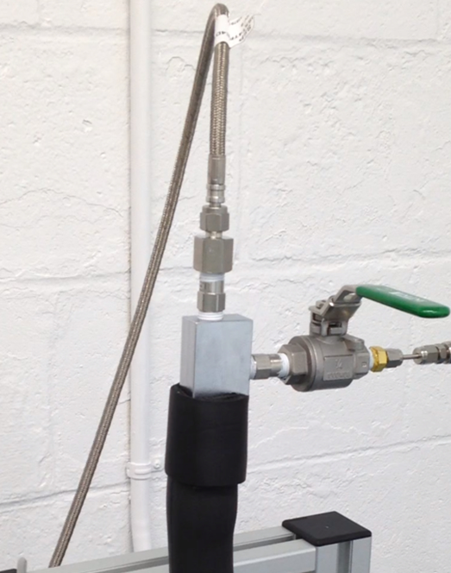
700007974: MBPR-Recycler inlet “braided” tubing
Replacement line has tube stubs so you will need 2 each of the following.
700006728: 1/4" Comp Nut Fitting,
700006637: 1/4" Comp Ferrule Set Fitting.

Slide 6
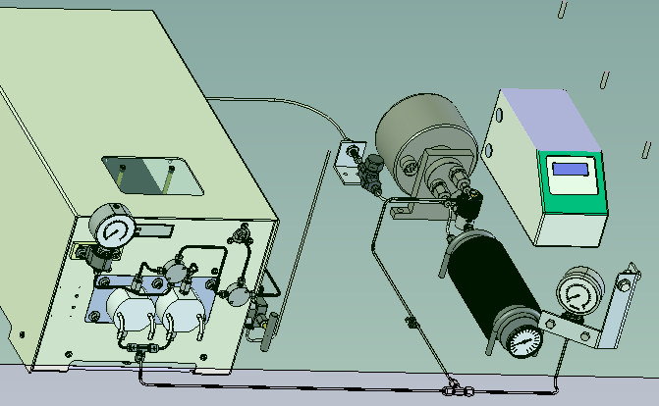
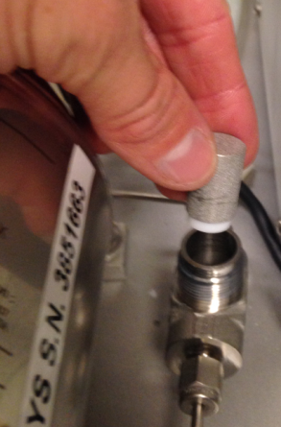
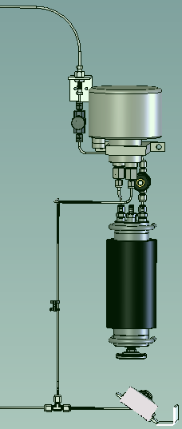
CO2 inlet to Extraction Skid
CO2
Filter Frit Kit
5 um filter=
700007354
700007292=1/8" Comp 5000PSI 5 Micron Inline Filter assembly

Slide 7
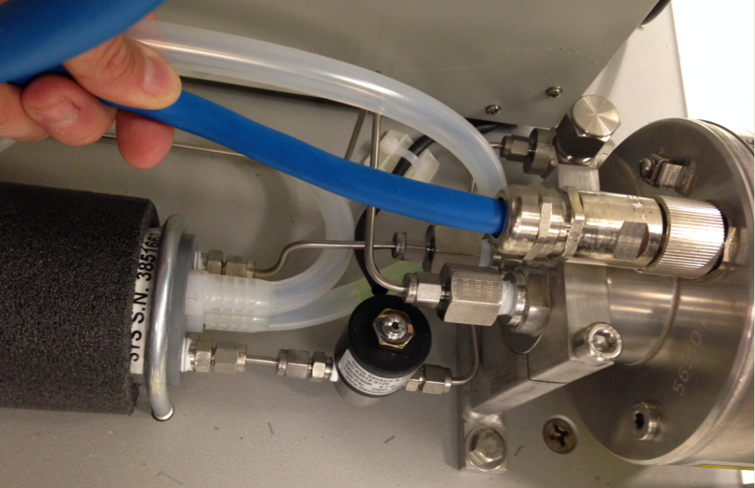
HE1
HE1= 700006862 Heat Exchanger Assy, CPVC 20' 6KPSI- Sys
HE1 inlet and outlet fittings are circled. It is a solid piece of tubing that passes through a bulkhead into the glycol filled, insulated cylinder. DO NOT remove fittings on HE1, but to solenoid and flow meter. New HE unit comes with extra long tubing that needs to be cut and bent to fit and female swagelok fittings also need to be ordered

Slide 8
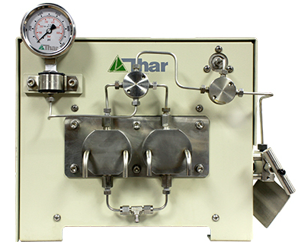
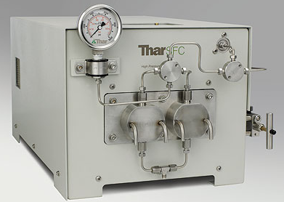
P-200

Slide 9
Common issues reported
Not delivering correct volume (RPM=Flow rate)
Bad CO2 supply
Check valves
Leaking seals
Amplifier
Broken piston
No Communications
No Power
Wrong address on pump
Bad Combo Board
Knocking sound
Creaking sounds

Slide 10
PM Kit: 700007688
Component number | Object description | Comp. Qty (CUn) | Component unit
700006543 | Seal, P-200A, GFPM, HVY-Med Spring | 2 | EA
700006542 | Ring, P-200 Piston Seal Peek Backup | 2 | EA
700006600 | Check Valve,3/8" DIA 10k PSI Cartridge | 4 | EA
700006911 | Wick, Oil - P-200A/P-350 | 2 | EA
700006572 | Spring, Piston P-200 P-350 | 2 | EA
Current Document Available:
P-200/P-350 High Pressure Pumps Performance Maintenance Technical Reference #715003915 REV. A on Portal—Service Assist

Slide 11
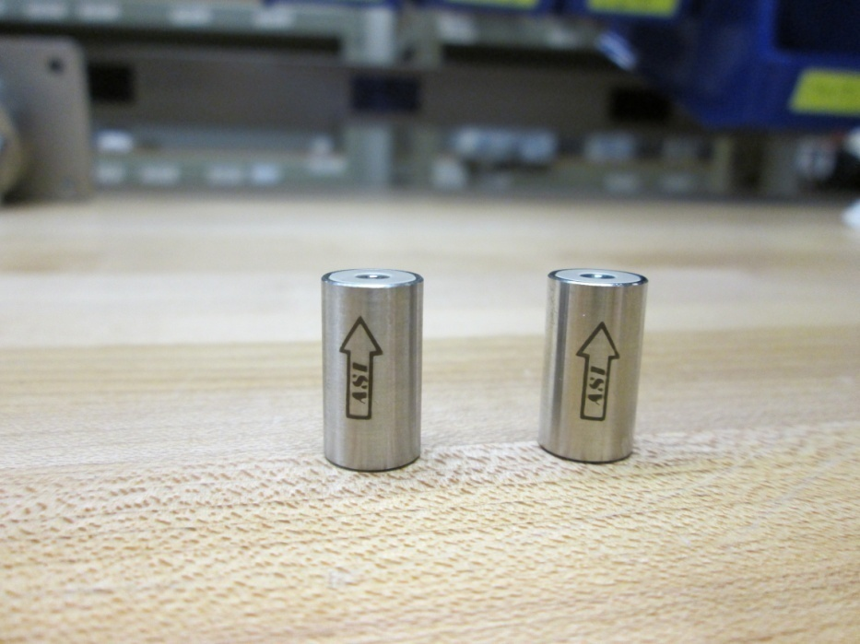
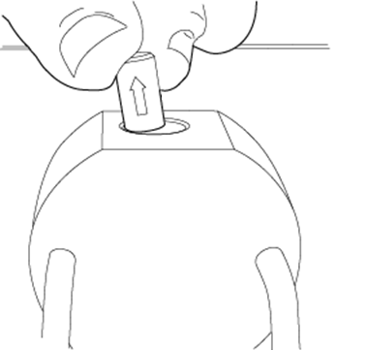
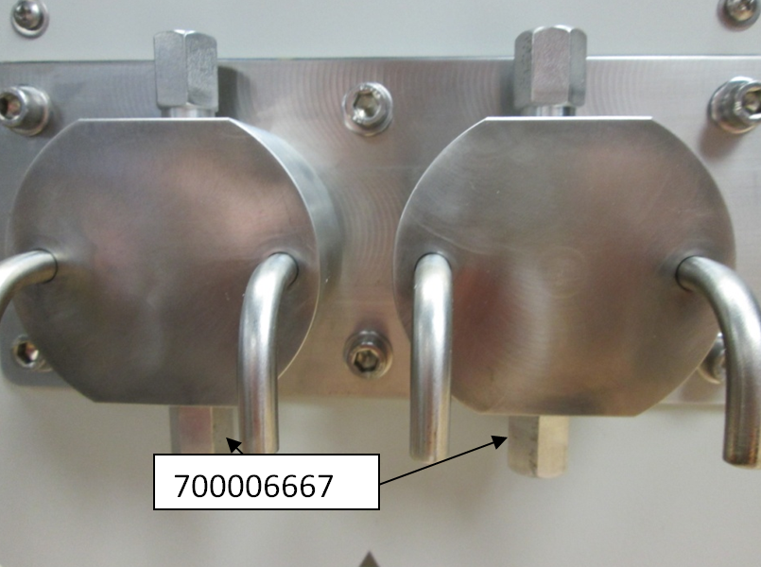
700006600:
3/8" DIA 10k PSI Cartridge Check Valve
700006667:
3/8" Dia. 1/2"-28x1/8 V Check Valve Holder

Slide 12
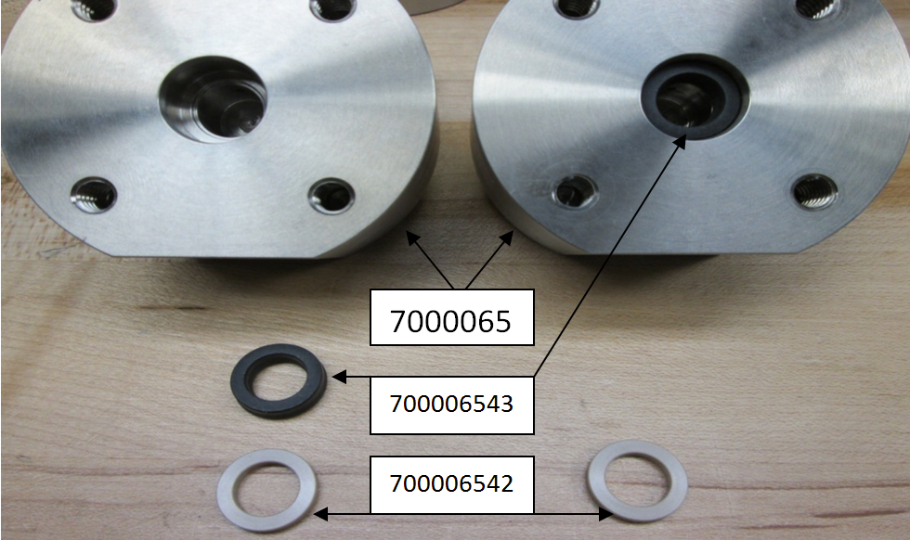
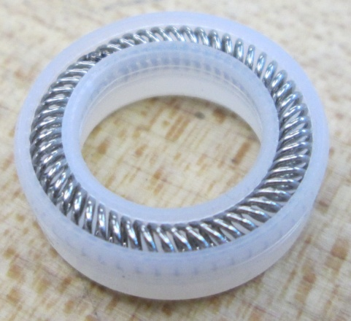
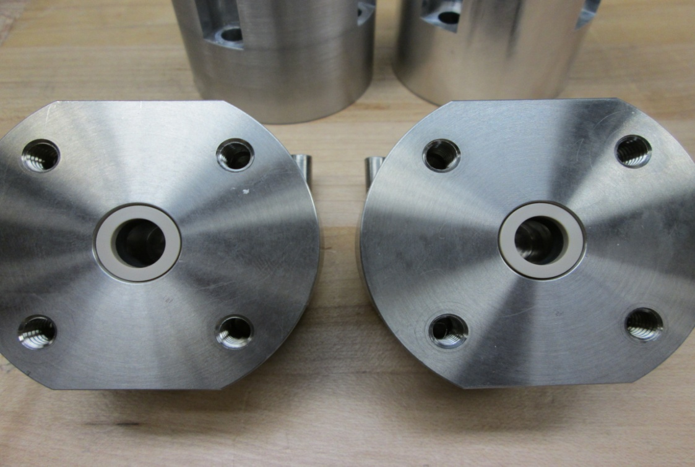
700006543:P-200A, GFPM, HVY-Med Spring Seal
(Spring faces into pump head)
The new PN is 700006607 and it is white rather than a black seal. We are going from the Graphite filled (black, PN 700006543) to UHMW material)
700006542:
Ring, P-200 Piston Seal Peek Backup

Slide 13
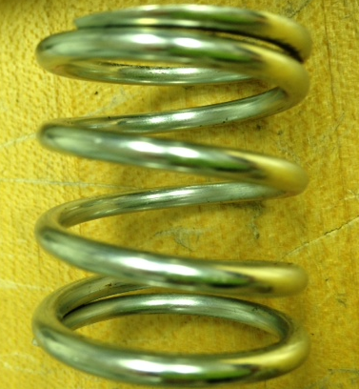
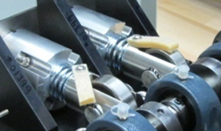
Piston Spring: 700006572
Oil Wick: 700006911
To oil the pump add about 3-4 drops
of 30W non-detergent motor oil monthly

Slide 14
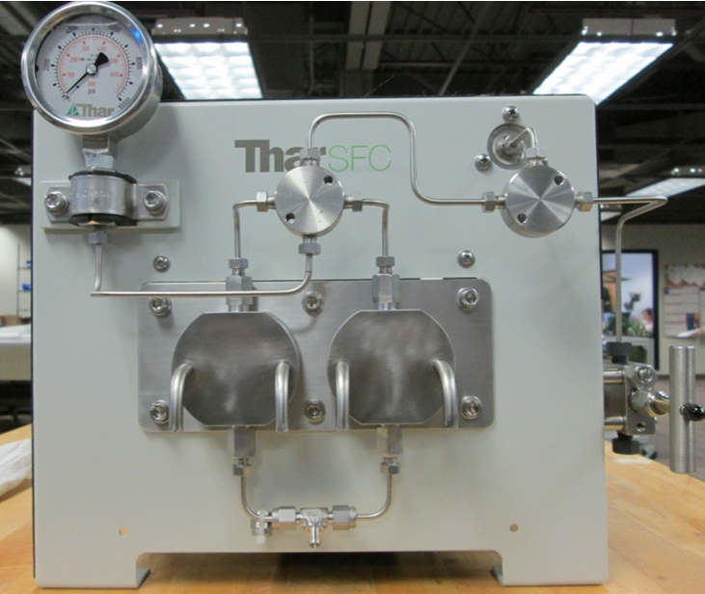
Unions and Fittings Part Numbers
700006639
1/8" V Tee - 2.00mm Bore
700006640
1/8" V Cross
700006548
10,000 PSI/Bar Dampened Gauge,
700006549
3 way needle valve
700006897
1/8" Comp Union Tee

Slide 15
Stainless Steel Tubing Part Numbers
High Pressure Tubing
PN: 01829
1/8"OD X .035"WL.
Straight 316SS
Low Pressure Tubing
PN: 05125
1/8"ODx.020"Wl 5' Straight 316SS
700006629: 1/8" V Nut and 700006630: 1/8" V Ferrule

Slide 16
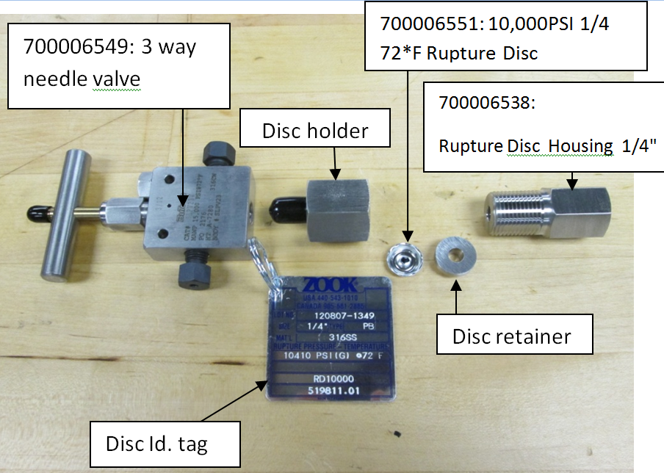
Isolation Valve and Rupture Disc Assembly

Slide 17
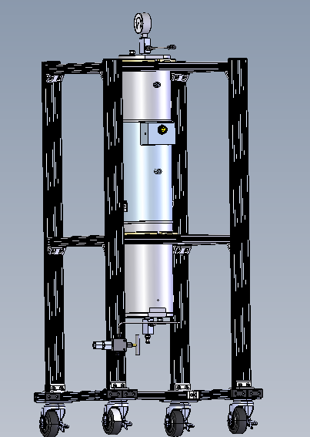
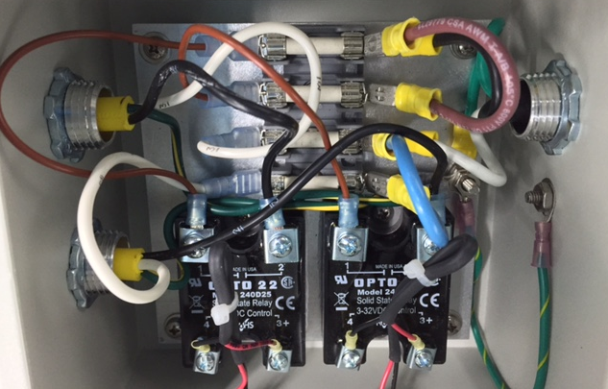
Fuses for Extraction Heater Relay (RB1)
CH1
V2
CH2
V1
Z1
Z3
Front of Unit

Slide 18
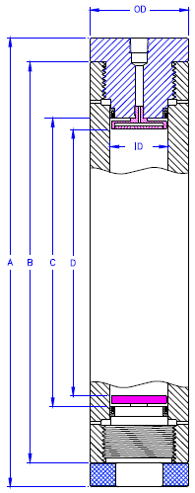
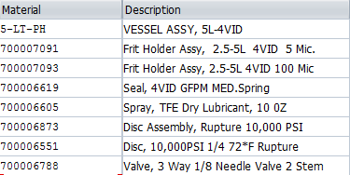
5L Extraction Vessel- Spare Parts
Fittings for connective line to HIP valves
Standard Frits for extraction vessels are 5um, but it is feasible for MMJ application to use 100um inlet and 5um outlet
700007128= Fitting, 1/4" NPT 316 SS Strt Tee 10KPSI 700006548=Gauge, 10,000 PSI/Bar Dampened.

Slide 19
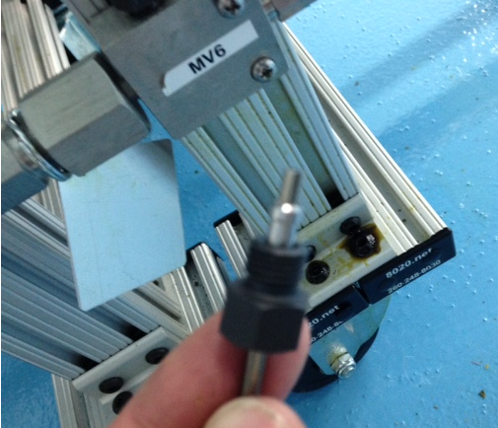
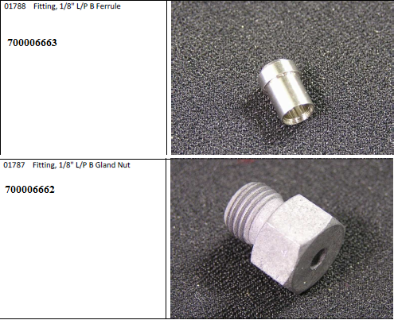
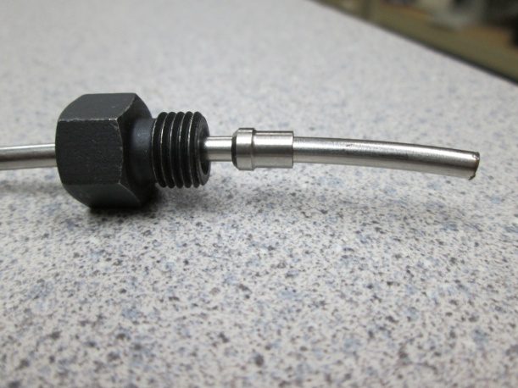
Drain Outlet of 5L vessel
Backwards ferrule
Correct

Slide 20
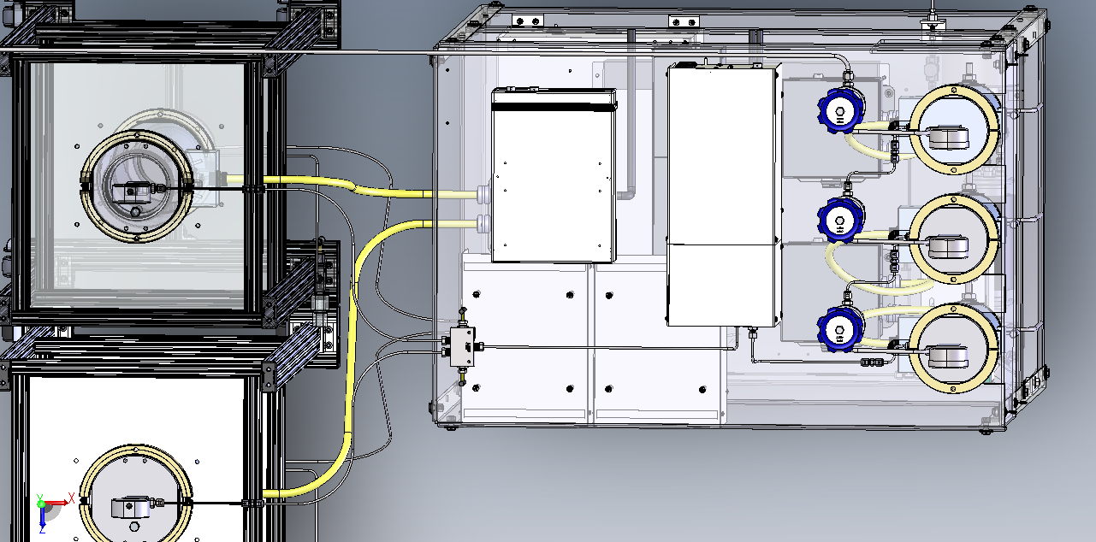
CH1
CH2
V1
V2
Front of Unit
Enhancements to system will have a short 6’ tubing with union to account for numerous disconnections the Vessel side will encounter…PN:430004396 Tubing Assy, SFE 5L Vessel Out to System

Slide 21
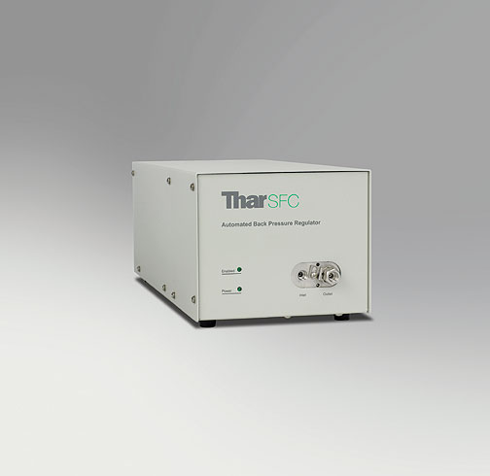
ABPR:PN-279002438
http://link.brightcove.com/services/player/bcpid1335863155001?bckey=AQ~~,AAAAzBCFxrk~,skRc699QmZb1foWIVXITl1Wj_d3qRqMC&bctid=3862626239001

Slide 22
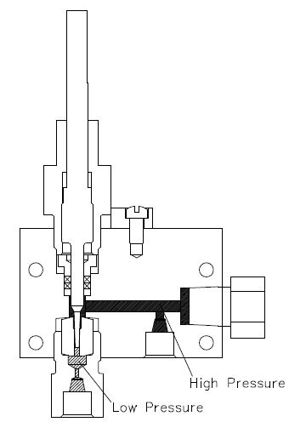
The zero point changes over time because CO2 or the extracted material erodes the peek seat
mobile phase with extracted material in as liquid form
Needle moves in and out of peek seat to regulate pressure
First place where extracted material or CO2 can crystallize due to delta P

Slide 23
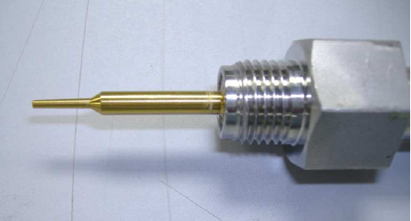
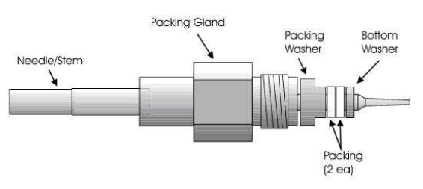
Moly-Disulfide Grease: 700007475
ABPR200 PM Kit: 700007693
Needle, 2 Degree: 700008887
Seat: 700008880
Packing Washer: 700006919
Packing (Teflon): 700006914
Bottom Washer(PEEK): 700006913

Slide 24
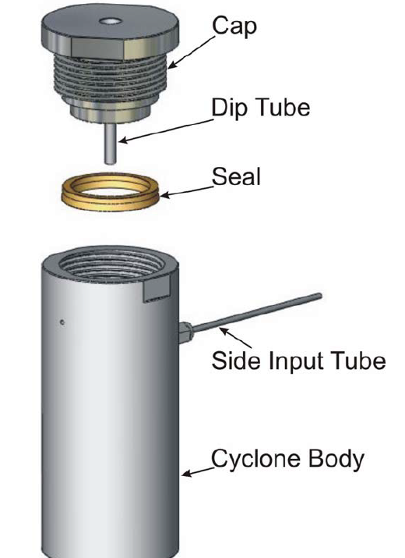
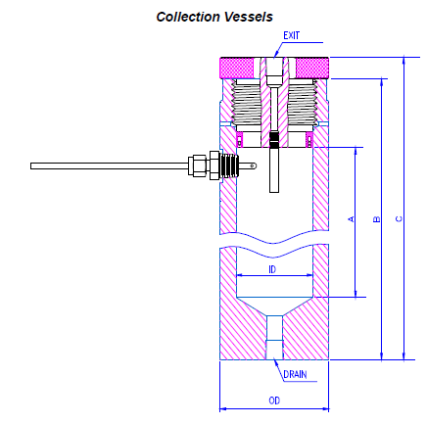
Collection Vessels

Slide 25
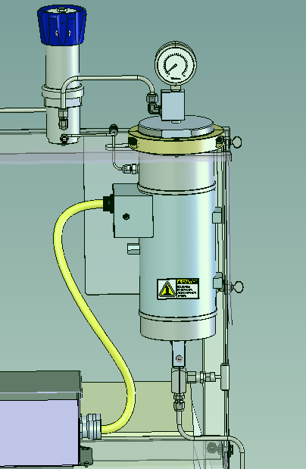
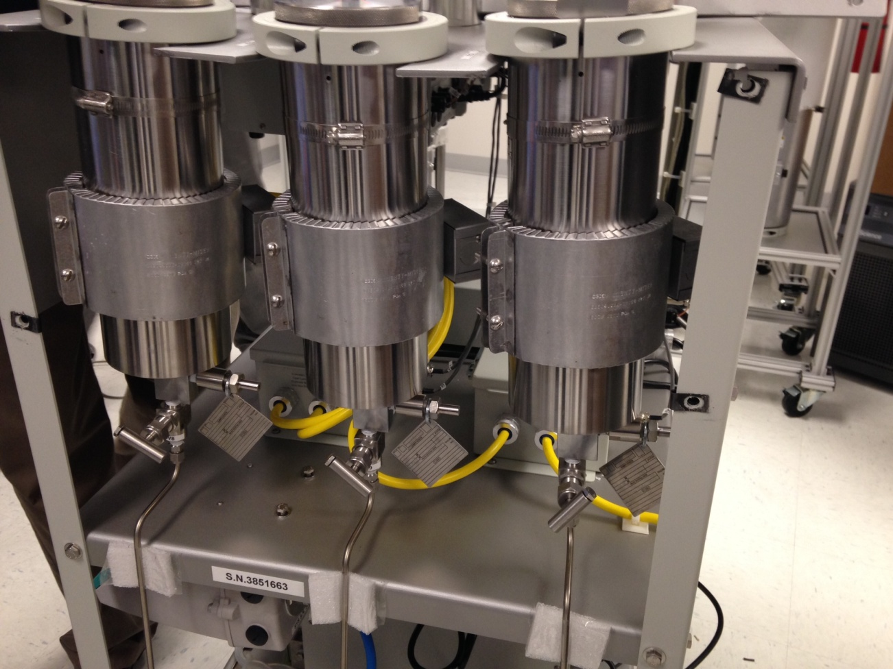
279003107
New, longer heaters
OLD

Slide 26
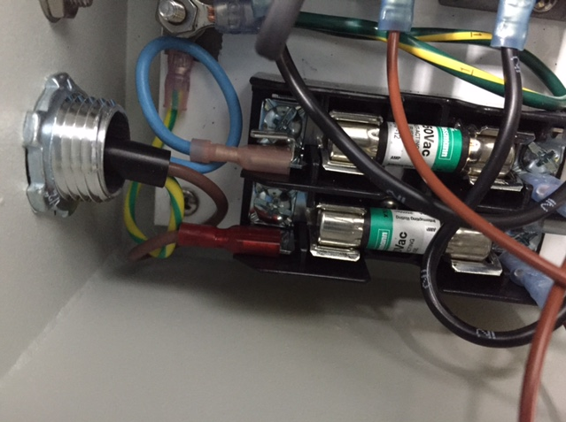
Collection Heater Relays: RB2 and RB3
700006917= Fuse, 12Amp 13/32" X 1-1/2" Baf Style

Slide 27
Collection Vessel Spare Parts
Spring Seal for Collection Vessel: 700006566
6Kpsi Gauge for Vessels 1 and 2: 700010093
1500psi Gauge for Vessel 3: 700006555
Needle valve for outlet: 700006617
6Kpsi Rupture Disc Assembly for Collection Vessels: 700007356
Rupture Disc 6Kpsi: 700006733
Vessel 3 uses 2Kpsi rupture disc: 405018415
Manual BPR for Vessels 1 and 2 (6Kpsi max):700010095
Manual BPR for Vessel 3 (2Kpsi max): 700010094

